Slide 1
Data Mining & Knowledge Discovery
IME 672
Lecture 3

Slide 2
Data Preprocessing

Slide 3
Why Preprocess the Data?
Low-quality data will lead to low-quality mining results
Major issues with Data Quality
Accuracy: correct or wrong, accurate or not, noisy, …
Completeness: not recorded, unavailable, …
Consistency: some modified but some not, dangling, …
Timeliness: timely update?
Believability: how trustable the data are correct?
Interpretability: how easily the data can be understood?

Slide 4
Major Tasks in Data Preprocessing
Data cleaning
Fill in missing values, smooth noisy data, identify or remove outliers, and resolve inconsistencies
Data integration
Integration of multiple databases, data cubes, or files
Data reduction
Dimensionality reduction
Numerosity reduction
Data transformation and data discretization
Normalization
Concept hierarchy generation

Slide 5
Data Cleaning
Data in the Real World is Dirty: Lots of potentially incorrect data, e.g., instrument faulty, human or computer error, transmission error
incomplete: lacking attribute values, lacking certain attributes of interest, or containing only aggregate data
e.g., Occupation = “ ” (missing data)
noisy: containing noise, errors, or outliers
e.g., Salary = “−10” (an error)
inconsistent: containing discrepancies in codes or names, e.g.,
Age = “42”, Birthday = “03/07/2010”
Was rating “1, 2, 3”, now rating “A, B, C”
intentional: (e.g., disguised missing data)
Jan. 1 as everyone’s birthday?

Slide 6
How to Handle Missing Data?
Ignore the tuple: usually done when class label is missing (when doing classification)
Fill in the missing value manually: tedious + infeasible
Fill in it automatically with
a global constant : e.g., “unknown”, a new class?!
the attribute mean / median
the attribute mean for all samples belonging to the same class
the most probable value: regression, inference-based such as Bayesian formula or decision tree

Slide 7
How to Handle Noisy Data?
Binning
first sort data and partition into (equal-frequency) bins
then one can smooth by bin means, smooth by bin median, smooth by bin boundaries, etc.
Regression
smooth by fitting the data into regression functions
Clustering
detect and remove outliers
Combined computer and human inspection
detect suspicious values

Slide 8
Data Integration
Data integration
Combines data from multiple sources into a coherent store
Schema integration: e.g., A.cust-id ≡ B.cust-#
Integrate metadata from different sources
Entity identification problem:
How can equivalent real-world entities from multiple data sources be matched up?
Detecting and resolving data value conflicts
For the same real world entity, attribute values from different sources are different
Possible reasons: different representations, different scales, e.g., metric vs. British units

Slide 9
Handling Redundancy in Data Integration
Redundant data occurs often when integration of multiple databases
Object identification: The same attribute or object may have different names in different databases
Derivable data: One attribute may be a “derived” attribute in another table, e.g., annual revenue
Redundant attributes can be detected by correlation and covariance analysis
Careful integration of the data from multiple sources may help reduce/avoid redundancies and inconsistencies and improve mining speed and quality

Slide 10
Correlation Analysis (Nominal Data)
Χ² (chi-square) test
The larger the Χ² value, the more likely the variables are related
Correlation does not imply causality
# of hospitals and # of car-theft in a city are correlated
Both are causally linked to the third variable: population

Slide 11
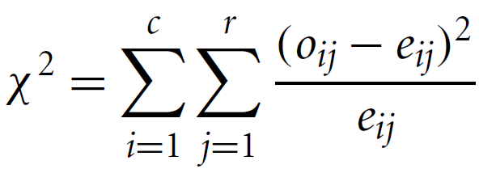
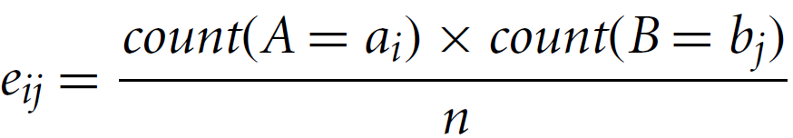
Correlation Analysis (Nominal Data)
Correlation relationship between two attributes, A and B
A has c distinct values and B has r
Contingency table: c values of A are the columns and r values of B the rows
(A_{i} ,B_{j}): joint event that attribute A takes on value a_{i} and attribute B takes on value b_{j}
o_{ij} = observed frequency, e_{ij} = expected frequency

Slide 12
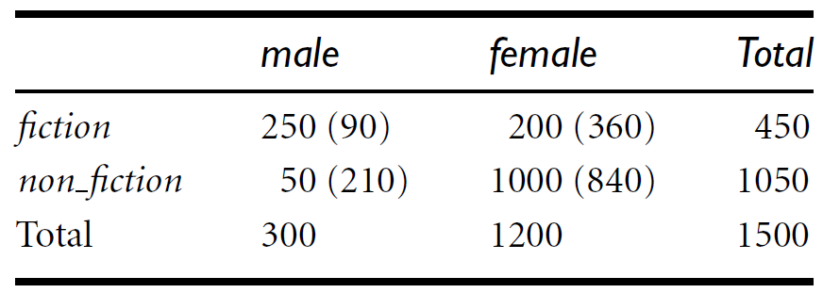

Example
A group of 1500 people was surveyed
Gender of each person was noted
Preferred type of reading: fiction or nonfiction

Slide 13
Correlation Analysis (Numeric Data)
Correlation coefficient (also called Pearson’s product moment coefficient)
where n is the number of tuples, and are the respective means of A and B, σ_{A} and σ_{B} are the respective standard deviation of A and B, and Σ(a_{i}b_{i}) is the sum of the AB cross-product
-1 <= r_{A,B} <= +1
If r_{A,B} > 0, A and B are positively correlated (A’s values increase as B’s). The higher, the stronger correlation.
r_{A,B} = 0: independent; r_{AB} < 0: negatively correlated

Slide 14
Data Reduction Strategies
Objective: Obtain a reduced representation of the data set that is much smaller in volume but yet produces the same (or almost the same) analytical results
Why? — Complex data analysis may take a very long time to run on the complete data set
Data reduction strategies
Dimensionality reduction
Wavelet transforms
Principal Components Analysis (PCA)
Attribute/Feature subset selection, feature creation
Numerosity reduction
Regression and Log-Linear Models
Histograms, clustering, sampling
Data cube aggregation
Data compression

Slide 15
Attribute Subset Selection
Irrelevant, weakly relevant, or redundant attributes or dimensions are detected and removed
Redundant attributes
E.g., purchase price of a product and the amount of sales tax paid
Irrelevant attributes
Contain no information that is useful for the data mining task at hand
E.g., students' ID is often irrelevant to the task of predicting students' GPA

Slide 16
Heuristic Search in Attribute Selection
There are 2^{d} possible attribute combinations of d attributes
An exhaustive search for the optimal subset of attributes can be prohibitively expensive
Typical heuristic attribute selection methods:
Stepwise forward selection
Stepwise backward elimination
Combination of forward selection and backward elimination
Decision tree induction

Slide 17
Attribute Creation (Feature Generation)
Create new attributes (features) that can capture the important information in a data set more effectively than the original ones
E.g., attribute area based on the attributes length and width
Attribute construction can discover missing information about the relationships between attributes that can be useful for KD

Slide 18
Data Reduction 2: Numerosity Reduction
Reduce data volume by choosing alternative, smaller forms of data representation
Parametric methods
Assume the data fits some model, estimate model parameters, store only the parameters, and discard the data (except possible outliers)
E.g.: regression
Non-parametric methods
Do not assume models
Major families: histograms, clustering, sampling, …

Slide 19
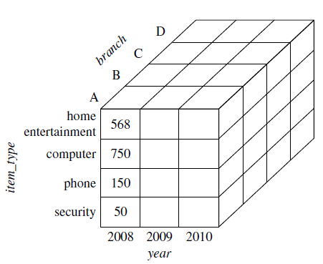
Data Cube Aggregation
Data cubes store multidimensional aggregated information

Slide 20
Data Cube
A data cube allows data to be modeled and viewed in multiple dimensions
Dimensions: perspectives or entities with respect to which an organization wants to keep records
Sales DW: records store’s sales w.r.t. dimensions time, item, branch, and location
Facts: numeric measures, quantities by which relationships are analyzed between dimensions
Sales in $, units sold
n-dimensional

Slide 21
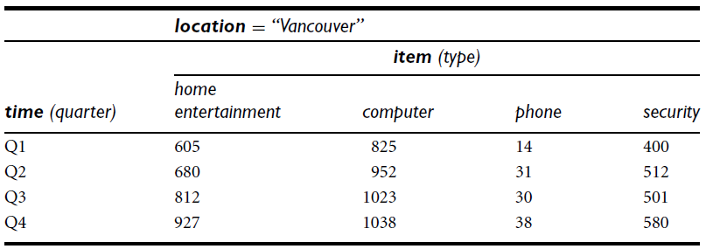
2-D Data Cube
The sales are from branches located in the city of Vancouver. The measure displayed is dollars sold (in thousands)

Slide 22
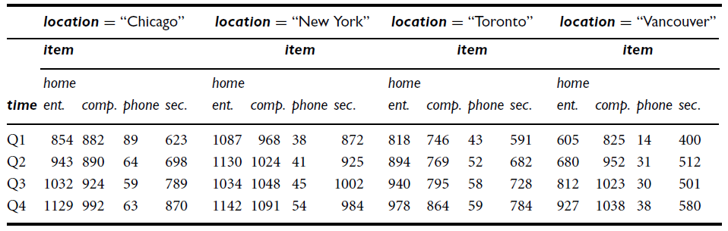
3-D Data Cube

Slide 23
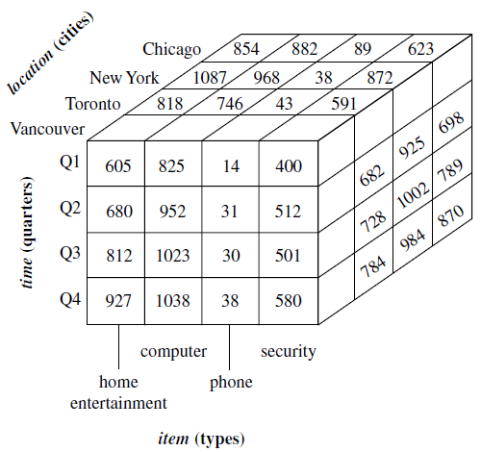
3-D Data Cube

Slide 24
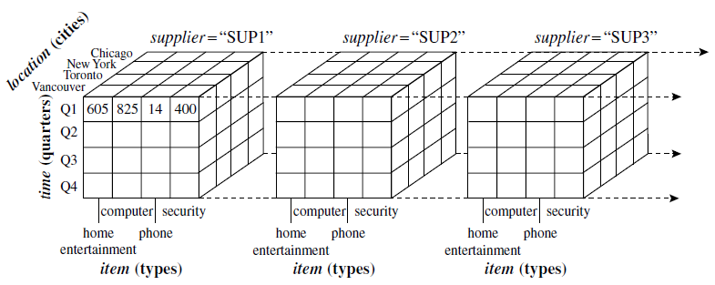
4-D Data Cube
display any n-dimensional data as a series of (n-1)-dimensional “cubes”

Slide 25
Lattice
Data cubes often referred as Cuboids in DW literature
Given a set of dimensions, a cuboid can be generated for each of the possible subsets of the given dimensions
Lattice of cuboids - each showing the data at a different level of summarization, or group-by
Base cuboid - lowest level of summarization
Apex cuboid - highest level of summarization

Slide 26
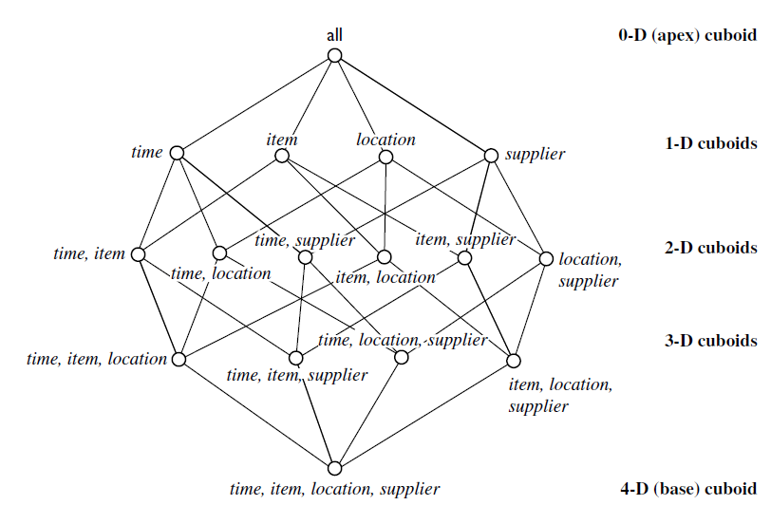
A Lattice of Cuboids

Slide 27
Data Warehouse
Definition
a subject-oriented, integrated, time-variant, and nonvolatile collection of data in support of management’s decision-making process
A decision support database that is maintained separately from the organization’s operational database
Supports information processing by providing a solid platform of consolidated, historical data for analysis

Slide 28
Data Warehouse—Subject-Oriented
Organized around major subjects, such as customer, product, sales
Focusing on the modeling and analysis of data for decision makers, not on daily operations or transaction processing
Provide a simple and concise view around particular subject issues by excluding data that are not useful in the decision support process

Slide 29
Data Warehouse—Integrated
Constructed by integrating multiple, heterogeneous data sources
relational databases, flat files, on-line transaction records
Data cleaning and data integration techniques are applied
Ensure consistency in naming conventions, encoding structures, attribute measures, etc. among different data sources
E.g., Hotel price: currency, tax, breakfast covered, etc.

Slide 30
Data Warehouse—Time Variant
The time horizon for the data warehouse is significantly longer than that of operational systems
Operational database: current value data
Data warehouse data: provide information from a historical perspective (e.g., past 5-10 years)
Key structure in the data warehouse
Contains an element of time, explicitly or implicitly
But the key of operational data may or may not contain “time element”

Slide 31
Data Warehouse—Nonvolatile
A physically separate store of data transformed from the operational environment
Operational update of data does not occur in the data warehouse environment
Does not require transaction processing, recovery, and concurrency control mechanisms
Requires only two operations in data accessing:
initial loading of data and access of data

Slide 32
Data Warehouse Usage
Information processing
supports querying, basic statistical analysis, and reporting using crosstabs, tables, charts and graphs
Analytical processing
supports basic OLAP operations, slice-dice, drilling, pivoting
Data mining
knowledge discovery from hidden patterns

Slide 33
Data Warehouse: A Multi-Tiered Architecture
Monitor
&
Integrator
OLAP Server
Other
sources
Metadata
Analysis
Query
Reports
Data mining
Operational
DBs
Extract
Transform
Load
Refresh
Data
Warehouse
Serve
Data Marts
Data Sources
Data Storage
OLAP Engine
Front-End Tools

Slide 34
Data Reduction 3: Data Compression
String compression
Typically lossless
Audio/video compression
Typically lossy compression
Dimensionality and numerosity reduction may also be considered as forms of data compression

Slide 35
Data Transformation
A function that maps the entire set of values of a given attribute to a new set of replacement values
Objective – make mining process more efficient, and patterns found easier to understand
Methods
Smoothing: Remove noise from data
Attribute/feature construction
New attributes constructed from the given ones
Aggregation: Summarization, data cube construction
Normalization: Scaled to fall within a smaller, specified range
min-max normalization
z-score normalization
normalization by decimal scaling
Discretization: Concept hierarchy climbing

Slide 36
Normalization
Min-max normalization: to [new_min_{A}, new_max_{A}]
Z-score normalization (μ: mean, σ: standard deviation):
Normalization by decimal scaling
where j is the smallest integer such that max(|ν’|) < 1

Slide 37
Discretization
Divide the range of a continuous attribute into intervals
Interval labels can then be used to replace actual data values
Reduce data size by discretization
Supervised vs. unsupervised
Split (top-down) vs. merge (bottom-up)
Discretization can be performed recursively on an attribute

Slide 38
Data Discretization Methods
Typical methods: All the methods can be applied recursively
Binning
Top-down split, unsupervised
Histogram analysis
Top-down split, unsupervised
Clustering analysis (unsupervised, top-down split or bottom-up merge)
Decision-tree analysis (supervised, top-down split)
Correlation (e.g., χ²) analysis (unsupervised, bottom-up merge)

Slide 39
Discretization by Classification & Correlation
Classification (e.g., decision tree analysis)
Supervised: Given class labels
Using entropy to determine split point (discretization point)
Top-down, recursive split
Correlation analysis (e.g., Chi-merge: χ²-based discretization)
Supervised: use class information
Bottom-up merge: find the best neighboring intervals (those having similar distributions of classes, i.e., low χ² values) to merge
Merge performed recursively, until a predefined stopping condition

Slide 40
Concept Hierarchy Generation
Concept hierarchy organizes concepts (i.e., attribute values) hierarchically and is usually associated with each dimension in a data warehouse
Concept hierarchies facilitate drilling and rolling in data warehouses to view data in multiple granularity
Concept hierarchy formation: Recursively reduce the data by collecting and replacing low level concepts (such as numeric values for age) by higher level concepts (such as youth, adult, or senior)
Concept hierarchy can be automatically formed for both numeric and nominal data

Slide 41
Automatic Concept Hierarchy Generation
Some hierarchies can be automatically generated based on the analysis of the number of distinct values per attribute in the data set
The attribute with the most distinct values is placed at the lowest level of the hierarchy
Exceptions, e.g., weekday, month, quarter, year
country
15 distinct values
province_or_ state
365 distinct values
city
3567 distinct values
street
674,339 distinct values

Slide 42
Summary
Data quality: accuracy, completeness, consistency, timeliness, believability, interpretability
Data cleaning: e.g. missing/noisy values, outliers
Data integration from multiple sources:
Entity identification problem; Remove redundancies; Detect inconsistencies
Data reduction
Dimensionality reduction; Numerosity reduction; Data compression
Data transformation and data discretization
Normalization; Concept hierarchy generation

